Slide 1


A QUICK INFORMATION GUIDE TO FRONTEND DEVELOPMENT
Frontend Development Basics: HTML, CSS, and JavaScript
A Journey into Web Technologies and Their Roles

Slide 2


Frontend Development
Overview of key technologies in web development
Introduction to HTML and its structure
Understanding CSS for styling and layout
The role of JavaScript in interactivity
Examples of frontend applications and visuals
Best practices for frontend development

Slide 3

Understanding HTML: The Web's Foundation
HTML structures web content and provides meaning
HTML, or HyperText Markup Language, is crucial as it defines the structure of web pages. By using elements like headings, paragraphs, and links, HTML creates a clear hierarchy and makes content accessible to users and search engines alike.

Slide 4


Semantic Structure
HTML helps create a clear document outline, improving SEO and accessibility.
Key Features of HTML
Accessibility
Proper use of HTML elements ensures all users can access and navigate content.
Exploring HTML's essential role in web development
Media Integration
HTML enables seamless embedding of images, videos, and audio, enhancing user experience.

Slide 5
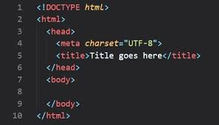
CSS: The Style of the Web
Enhancing web design through styling and layout
CSS, or Cascading Style Sheets, is essential for creating visually appealing websites. It allows developers to style HTML elements, define layouts, and implement responsive designs, making websites not only functional but also attractive.

Slide 6
Responsive Design
Adapts layouts to different devices for optimal viewing experiences.
Key Features of CSS
Animation Effects
Brings static elements to life, enhancing user engagement and interaction.
Exploring essential aspects that enhance web development design
Layout Control
Provides flexibility in positioning elements, creating structured and visually appealing designs.

Slide 7
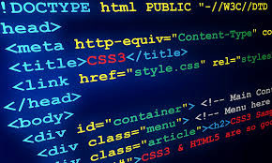
JavaScript: Enhancing User Interactivity
Understanding how JavaScript transforms web experiences
JavaScript is essential for dynamic content and user engagement. It allows developers to create interactive elements, such as forms and animations, making web pages more responsive and lively for users.

Slide 8
DOM Manipulation
Enables dynamic changes to HTML elements, enhancing user experience.
Key Features of JavaScript
Event Handling
Captures user interactions, allowing responsive actions and updates.
Exploring essential concepts for frontend web development
AJAX for Asynchronous Requests
Facilitates data retrieval without refreshing the page, improving performance.

Slide 9

“The web is a platform for collaboration and creativity, where individuals can share their ideas and connect with others across the globe, shaping the future of our digital landscape.”
– TIM BERNERS-LEE

Slide 10
THANK-YOU
TEAM MEMBERS
RISHABH DEV PANDEY
RITEK CHAUDHARY
PRITHVI DEV SINGH
PRANJAL SHARMA
PRAVISH MISRA
RISHIKANT CHAUHAN
PRAYANJAL TIWARI

